Slide 1
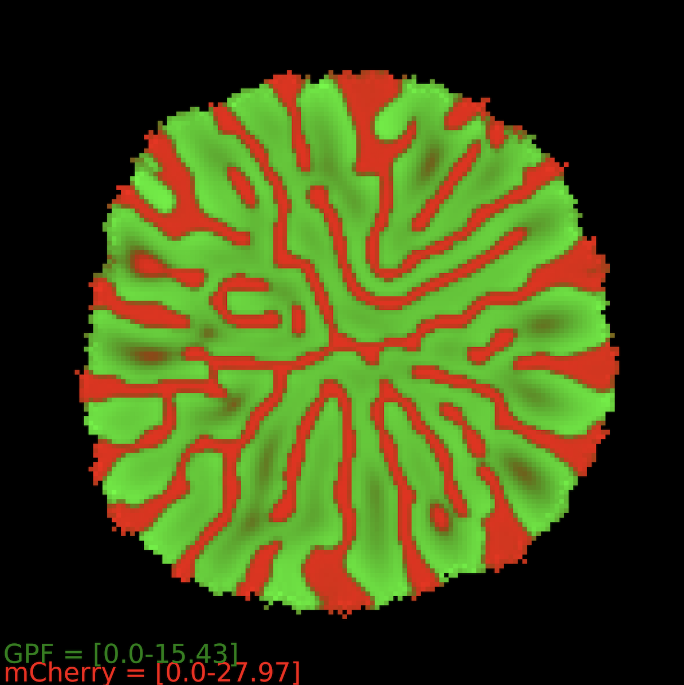
Solving the Turing robustness problem: extending most robust 3 node network to 4 nodes
MSc in Bioinformatics and Theoretical Systems Biology
Supervisors
Prof. Robert Endres
Martina Oliver Huidobro (PhD student)

Slide 2
What are Turing patterns?
What are Turing patterns?
Patterns in biological systems
Alan Turing 1952
Notes:
In 1952 Alan Turing developed a theory that explained how patterns in chemical systems can self-assemble to form dots, stripes or laberynths.
-----

Slide 3
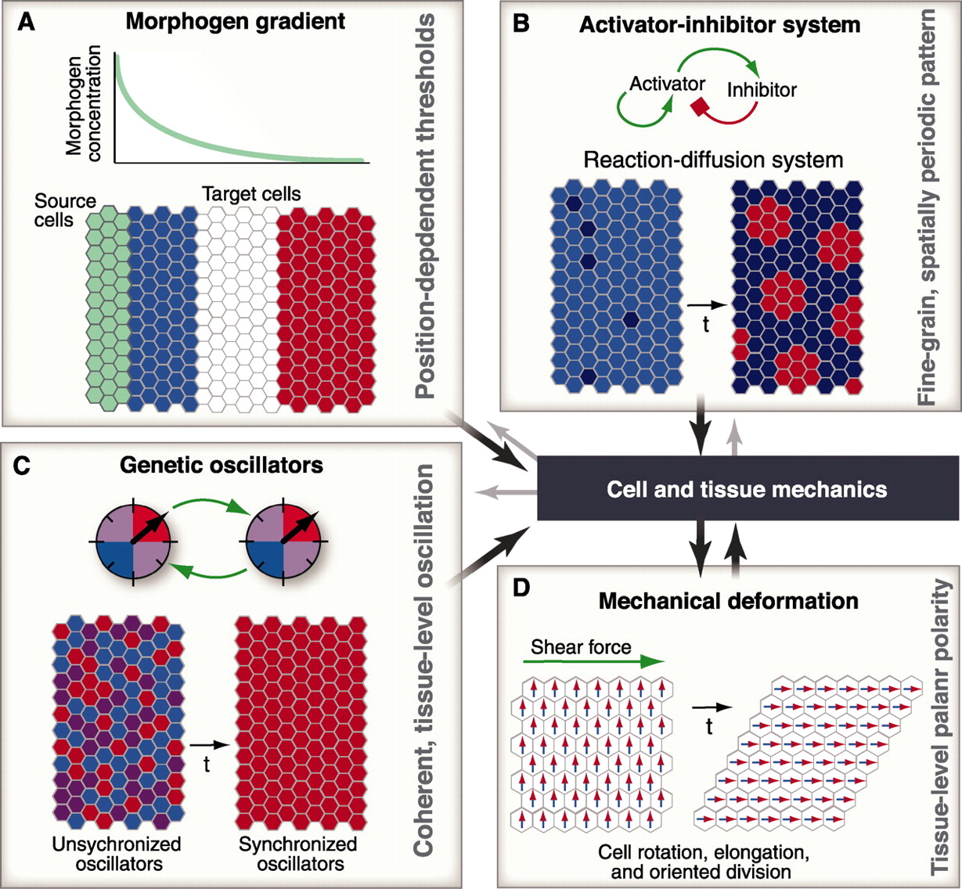
Reaction-Diffusion system described by Turing
Turing, 1952
Gierer & Meinhardt, 1972
Notes:
The chemical network that Alan Turing described consists of a slow diffusing activator and a fast diffusing inhibitor.
The nature of this network gives rise to local activation long range inhibition, resulting in a tissue with the peaks and throphs seen here.
Applied to 2D, you obtain the pretty patterns observed in this image where the red color corresponds to a high concentration of a molecule.
There are two reasons why we are interested in engineering turing patterns in biofilms. Firstly, this theory is widely used by developmental biologists to understand processes in morphogenesis, so engineering these systems would further prove the importance of Turing patterns in nature. Furthermore, it would be interesting to apply Turing’s mechanism to biological cells to obtain synthetic patterns in biofilms for downstream bioengineering applications.
----
Turing network: activator and inhibitor. Activator diffuses slowly and inhibitor fast. Local activation and Long range inhibition. Peaks and throphs.
The aims of synthetic biology is to replicate these patterns in vitro.

Slide 4
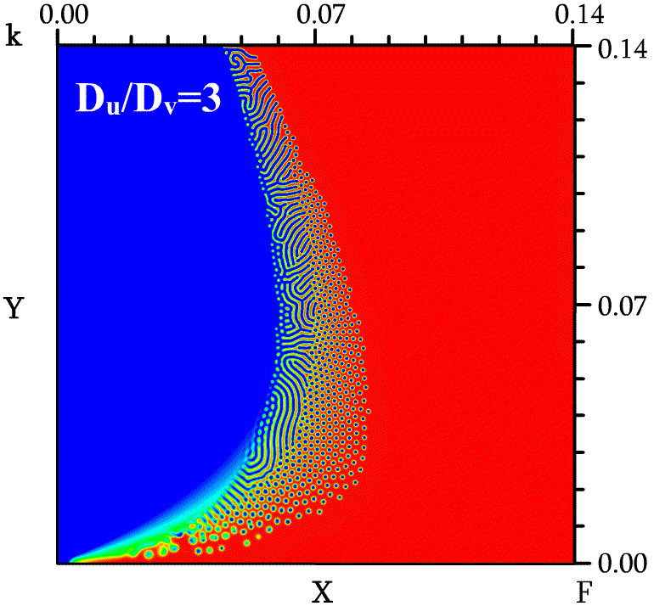
Turing patterns are not robust
Reaction-Diffusion system described by Turing
X and Y being model parameters…
http://complex.upf.es/~andreea/PACE/Self-replicating_spots.html
Notes:
The chemical network that Alan Turing described consists of a slow diffusing activator and a fast diffusing inhibitor.
The nature of this network gives rise to local activation long range inhibition, resulting in a tissue with the peaks and throphs seen here.
Applied to 2D, you obtain the pretty patterns observed in this image where the red color corresponds to a high concentration of a molecule.
There are two reasons why we are interested in engineering turing patterns in biofilms. Firstly, this theory is widely used by developmental biologists to understand processes in morphogenesis, so engineering these systems would further prove the importance of Turing patterns in nature. Furthermore, it would be interesting to apply Turing’s mechanism to biological cells to obtain synthetic patterns in biofilms for downstream bioengineering applications.
----
Turing network: activator and inhibitor. Activator diffuses slowly and inhibitor fast. Local activation and Long range inhibition. Peaks and throphs.
The aims of synthetic biology is to replicate these patterns in vitro.

Slide 5
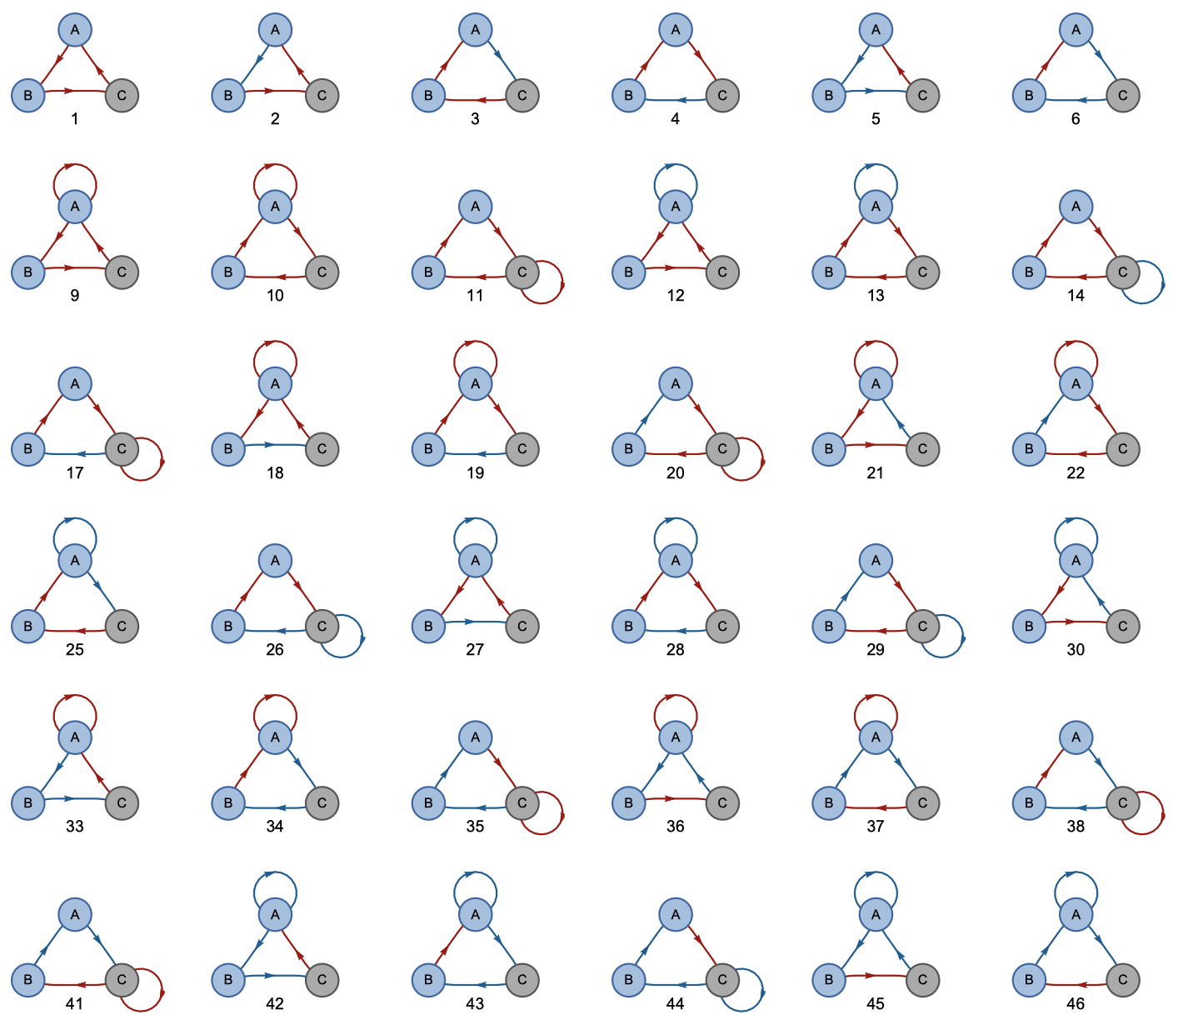
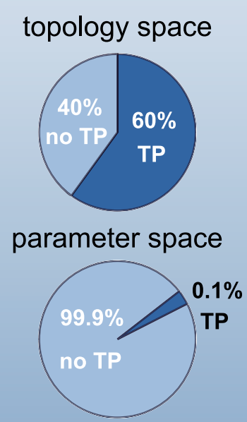
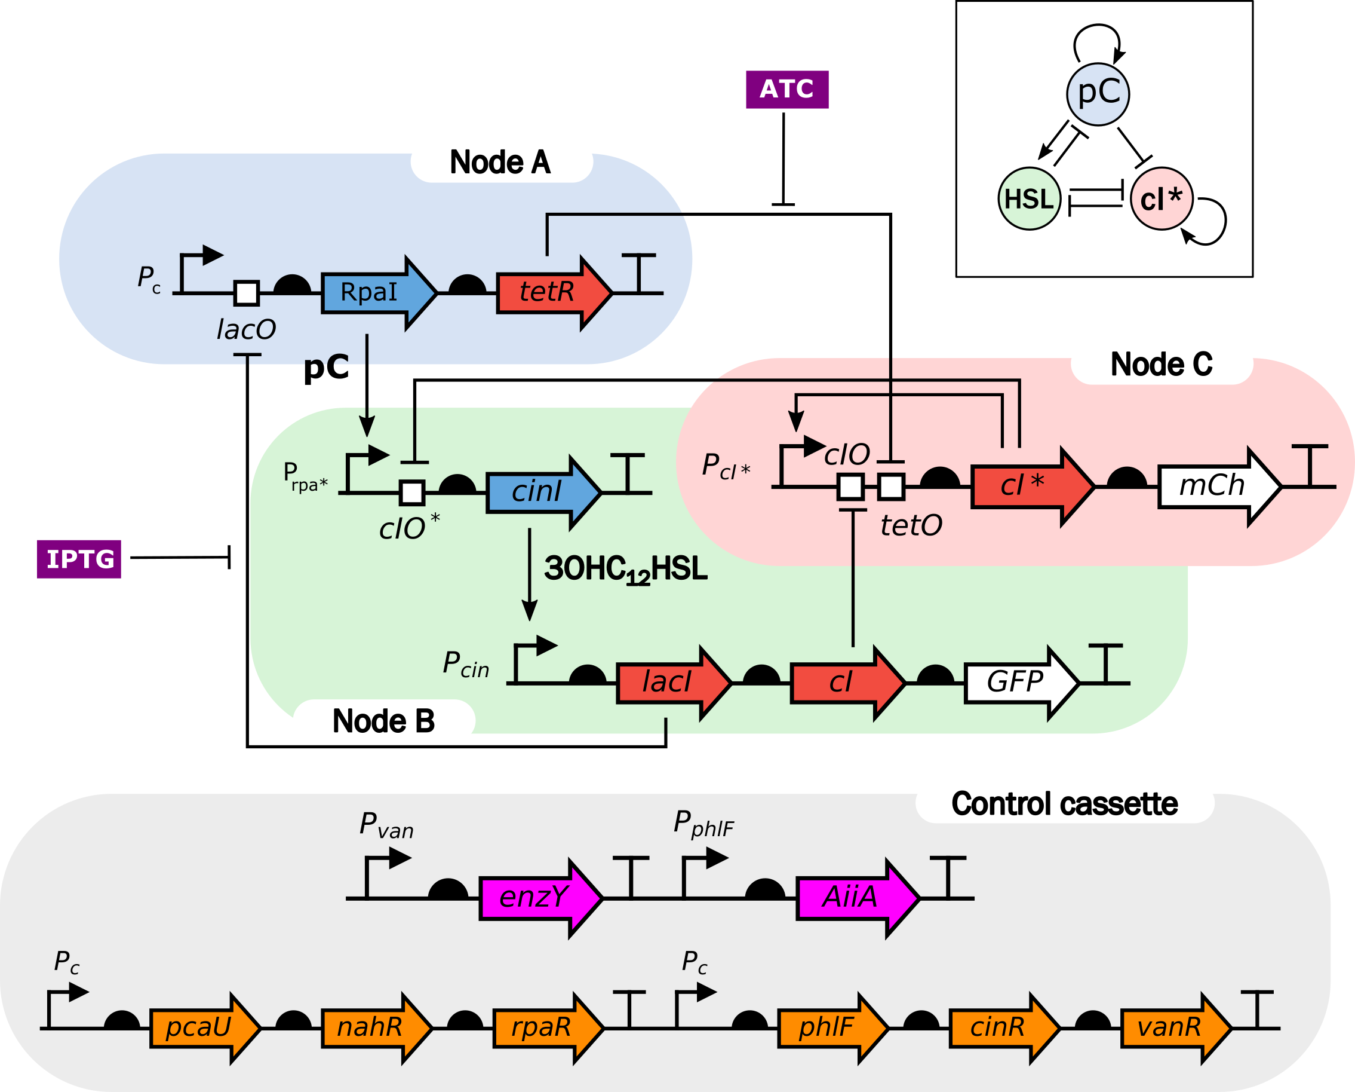
Atlas search measures global Turing robustness
Reaction-Diffusion system described by Turing
Sampling the parameter space of all 2 and 3 node networks
(Scholes et al. Cell Syst, 2019)
https://doi.org/10.1016/j.cels.2019.07.007
Notes:
The chemical network that Alan Turing described consists of a slow diffusing activator and a fast diffusing inhibitor.
The nature of this network gives rise to local activation long range inhibition, resulting in a tissue with the peaks and throphs seen here.
Applied to 2D, you obtain the pretty patterns observed in this image where the red color corresponds to a high concentration of a molecule.
There are two reasons why we are interested in engineering turing patterns in biofilms. Firstly, this theory is widely used by developmental biologists to understand processes in morphogenesis, so engineering these systems would further prove the importance of Turing patterns in nature. Furthermore, it would be interesting to apply Turing’s mechanism to biological cells to obtain synthetic patterns in biofilms for downstream bioengineering applications.
----
Turing network: activator and inhibitor. Activator diffuses slowly and inhibitor fast. Local activation and Long range inhibition. Peaks and throphs.
The aims of synthetic biology is to replicate these patterns in vitro.

Slide 6
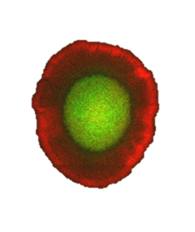
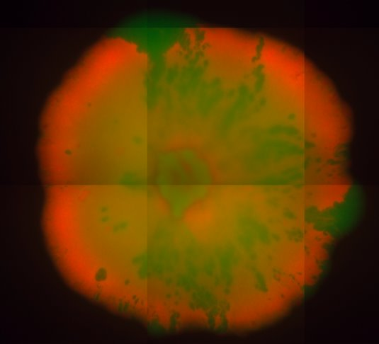
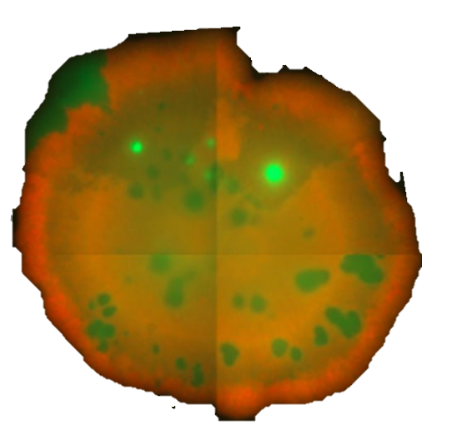
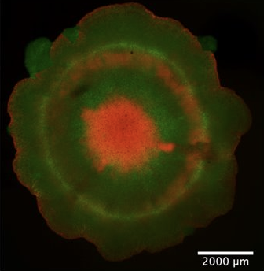
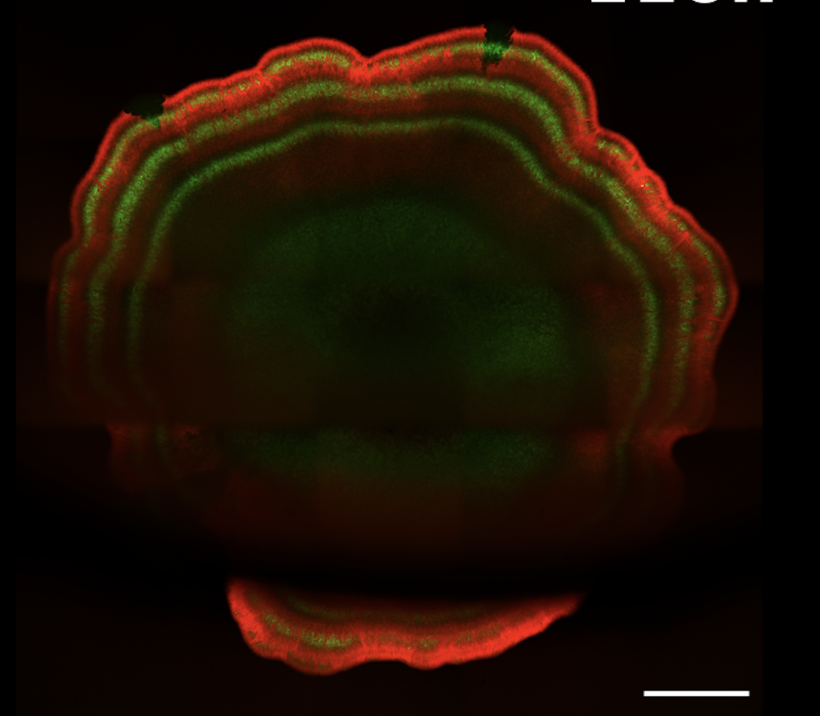
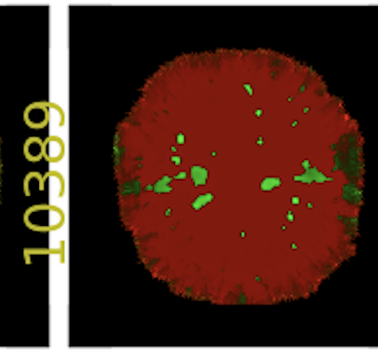
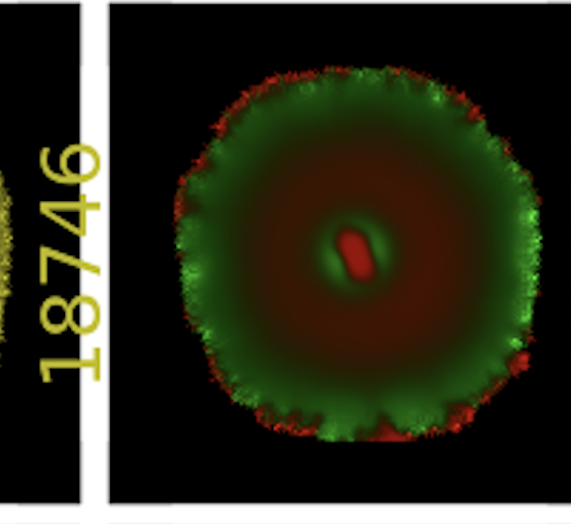
Experimental implementation of 3 node network
Labyrinths
Small spots
Concentric rings
Red edge
Black hole
Wedges
Bulls-eye
Experiment
Not found
?
Model
Not found
Notes:
Turing robustness or pattern shape robustness

Slide 7
Project aim
Equations describing synthetic network
Based on random network theory, our hypothesis is that larger networks are more robust
Hence, investigate all 81 possible 4-node topologies based on most robust 3-node network #3954
e.g.
4
Scholes et al. Cell Syst (2019)
Notes:
The model developed describes the change in concentration of each of the 6 species over time in space.
Overall, the total number of unknown parameters is 22, which are being floated when exploring the circuit. Therefore making it a 22 dimensional parameter space to explore.
A parameter search was carried out to asses the turing capabilities of the circuit

Slide 8
Project organization
ATLAS: Extending the #3954 3-node network to create all possible 4 node networks (81 topologies)
SEARCH: Create relevant parameter sets to sample the parameter space
SOLVE: Solve for steady states and use linear stability analysis
CLASSIFY: Develop algorithm to classify based on dispersion relation
→ Answer question whether any new 4-node networks have increased robustness compared to #3954
Notes:
Prpa* is the promoter for pC

Slide 9
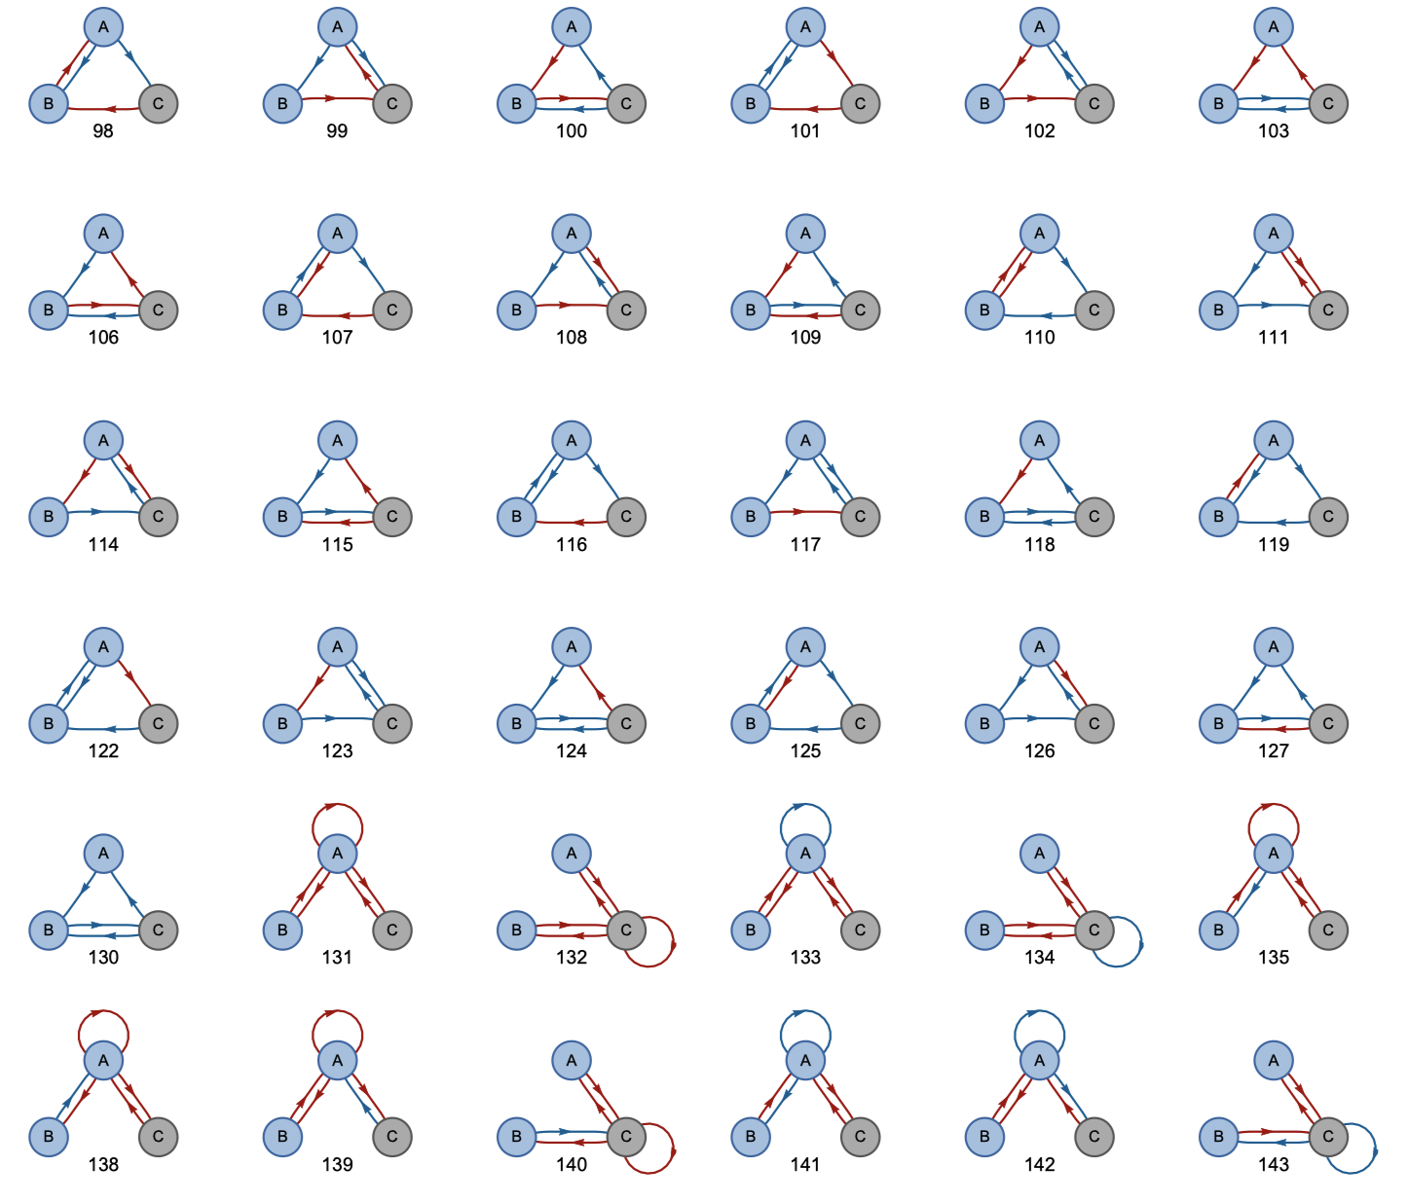
1. ATLAS
Create all possible 81 adjacency matrices
Not allowing unconnected networks
(new 4th node needs to be attached)
Notes:
Prpa* is the promoter for pC

Slide 10
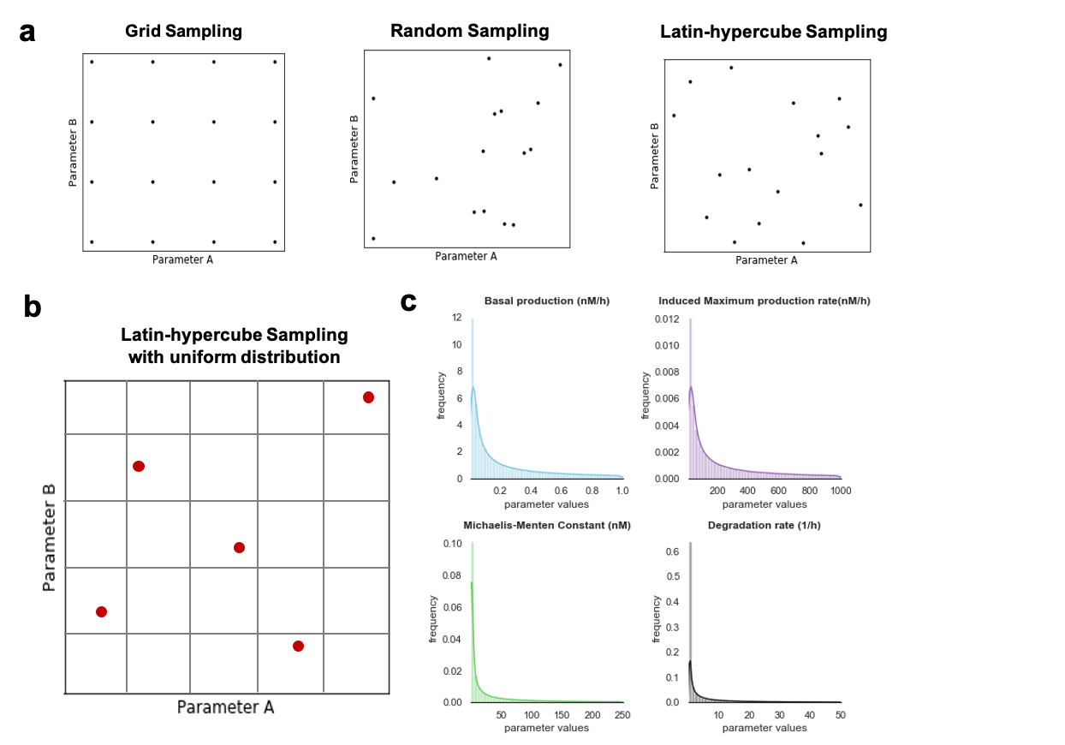
2. SEARCH
Sample parameter space
Notes:
Prpa* is the promoter for pC

Slide 11
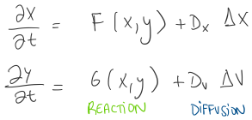
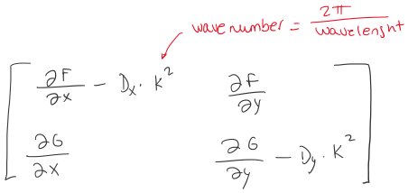
3. DISPERSION RELATION
Equations
Dispersion relation
Jacobian matrix
Notes:
Prpa* is the promoter for pC

Slide 12
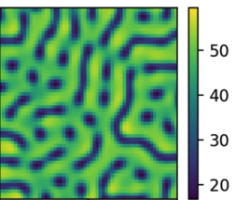
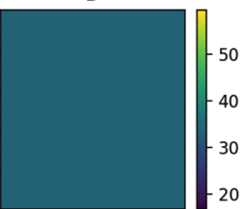
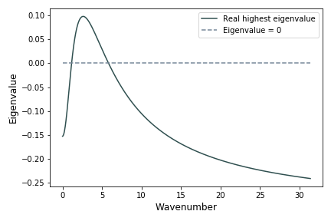
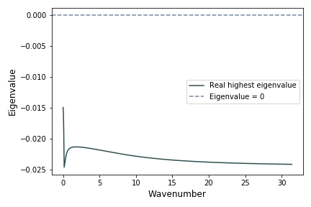
4. CLASSIFY TURING PARAMETER SETS
Dispersion peak
Turing Pattern
No Turing pattern
Dispersion peak
Notes:
Basically the dispersion relation is a plot showing the relationship between the growth of an instability (y axis) and the wavenumber (x axis). By looking at the dispersion relation, you can tell whether the system will produce Turing patterns. A positive peak will generate a Turing pattern (green), while a negative peak will not generate one (red).
At first sight this looks like a binary output, positive/negative, or in other words, pattern or no pattern. During this thesis I have explored a bit further and tried to understand not only positive or negative, but also, how does the height of the peak affect the characteristics of the pattern.

